Slide 1
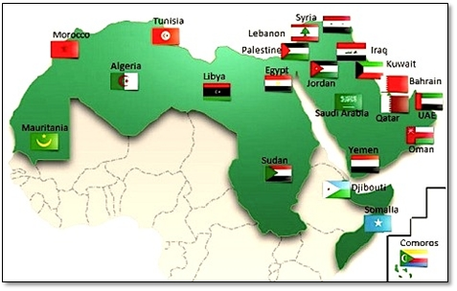

May - Arabic
Language of the month
Arabic is the main official national language in 22 countries in the Middle East and North Africa: Bahrain, Iraq, Jordan, Kuwait, Lebanon, Oman, Palestine, Qatar, Saudi Arabia, Syria, United Arab Emirates, Yemen, Algeria, Chad, Egypt, Libya, Morocco, Sudan, Tunisia, Mauritania, Comoros, and Djibouti.

Slide 2

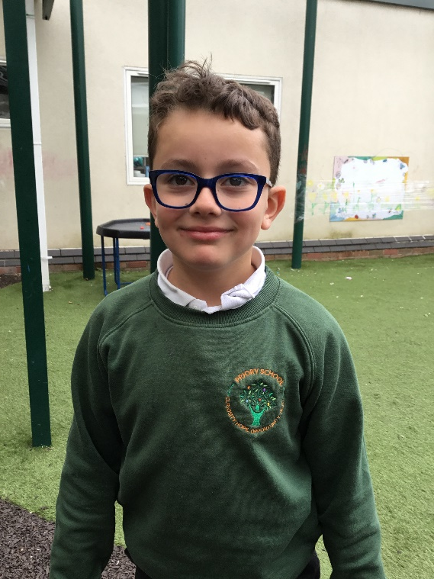
I can speak and write English and Arabic.
أستطيع التحدث والكتابة .باللغتين الإنجليزية والعربية
'astatie altahaduth walkitabat biallughatayn al'iinjiliziat walearabia
My name is Mahmod and I am Syrian.
اسمي محمود وأنا سوري
aismi mahmud wa'ana suri
I like to play football.
أحب لعب كرة القدم.
'uhibu laeib kurat alqadami.
May - Arabic
Language of the month
I like to eat chicken.
أحب أكل الدجاج.
'uhibu 'akl aldajaji.

Slide 3

The Register السجل
Sabah alkhair sayidati.
صباح الخير
سيدتي
Massao alkhir sayidati.
مساء الخير
سيدتي
Arabic | English
Sabah alkhair صباح الخير | Good morning
Sayidati سيدتي | Madam
Saidy سيدي | Sir
Massao alkhir مساء الخير | Good afternoon
Sabah alkhair saidy.
صباح الخير
سيدي
May - Arabic
Language of the month
Massao alkhir saidy.
مساء الخيرسيدي

Slide 4
Colours al'alwan الألوان
Alazrak
الأزرق
Alahmr
الأحمر
Alasfr
الأصفر
May - Arabic
Language of the month
Alakhdr
الأخضر
Albortkaly
البرتقالي
Colour song: https://www.youtube.com/watch?v=q07g-165esg&t=162s

Slide 5
Lunch ghada‘ غداء
Alakhdr
Mnfadlek
الأخضر
من فضلك
Ay lown?
أي لون؟
Albortkaly Shokrn lk
البرتقالي
شكرًا لك
Alasfr Mnfadlek
الأصفر
من فضلك
May - Arabic
Language of the month
Arabic | English
Mnfadlek من فضلك | please
Shokr lk شكرًا لك | thank you
Ay lown? أي لون؟ | Which colour?
Ghada' marzum غداء مرزوم | packed lunch
Alazrak Shokrn lk
الأزرق
شكرًا لك
Alahmr Shokrn lk.
الأحمرشكرًا لك

Slide 6
Good morning
Sabah alkhair
صباح الخير
Thank you
Shokrn lk
شكرًا لك
Yes
Naeam
نعم
Please
Mnfadlek
من فضلك
Hello
Mrhban
مرحبًا
Sorry
Asf
آسف
Well done
'ahsant
أحسنت
May - Arabic
Language of the month
No
La
لا
Goodbye
Mae alsalama
مع السلامة
Good afternoon
Massao alkhir
مساء الخير
Good morning song:
https://www.youtube.com/watch?v=FeIrUtlIxjw

Slide 7

One ١
Wahid
واحد
Three ٣
Thalatha
ثلاثة
Five ٥
Khamsa
خمسة
Two ٢
Aithnayn
اثنان
Four ٤
'arbaea
أربعة
Six ٦
Sita
ستة
Eight ٨
Thamania
ثمانية
May - Arabic
Language of the month
Ten ١٠
Eashra
عشرة
Seven ٧
Sabea
سبعة
Nine ٩
Tisea
تسعة
Numbers 1-10:
https://www.youtube.com/watch?v=_Hb6fDJxGPw

Slide 8
Useful websites:
Facts:
https://kids.nationalgeographic.com/geography/countries/article/yemen
Animals:
https://kids.nationalgeographic.com/animals/mammals/facts/caracal
Some fun facts:
https://dinolingo.com/amazing-facts-about-arabic-speaking-countries-you-didnt-know/?srsltid=AfmBOoobHFuOKipcp7kIsHvjUyfAeGansssA5Jd9HI5dh_rOWP3oZoIR
May - Arabic
Language of the month

Slide 9

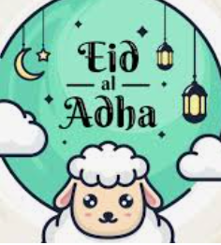
Eid Mubarak!
While Eid is celebrated by Muslims globally, it is the biggest holiday in Arab culture and throughout the Arab world. "Eid" itself is an Arabic word meaning "festival" or "feast".
The most common greeting, "Eid Mubarak," is Arabic for "Blessed Eid".
Eid ul-Adha ('Festival of Sacrifice') is one of the most important festivals in the Muslim calendar.
It lasts four days, starting around June 6, 2026, and involves special prayers, wearing new clothes, giving charity, sharing food with the poor, and enjoying festivities with family.
Short video clip of how Eid al-Adha is celebrated: https://www.bbc.co.uk/bitesize/articles/zwrvcxs
Eid Mubarak by Harris J: https://www.youtube.com/watch?v=qnxYiaHRPFY
May - Arabic
Language of the month

