Slide 1


BSL
British Sign Language
Sign Language Week 2026 takes place from 16th to 22nd March. It is organised by the British Deaf Association.
The theme is “United in Sign.” This means people come together to celebrate sign language. During this week, people learn about British Sign Language (BSL) and Irish Sign Language (ISL). These are real languages with their own rules and grammar. They are not just actions for English words. Sign language is very important to many Deaf people and is part of who they are.
Everyone is encouraged to learn some sign language. Schools often share free lessons so children can learn simple signs. Learning to sign is a kind way to include and support Deaf people.
In 2022, British Sign Language became legally recognised in the UK. Sign Language Week helps remind everyone that sign language matters and that we should make the world easier for Deaf people to learn, work, and communicate.
Schools, workplaces, and families can all join in and learn to sign together.
March – Sign Language
Language of the month

Slide 2





The Register
March – Sign Language
Good Morning
Hello
Language of the month
Good Afternoon

Slide 3

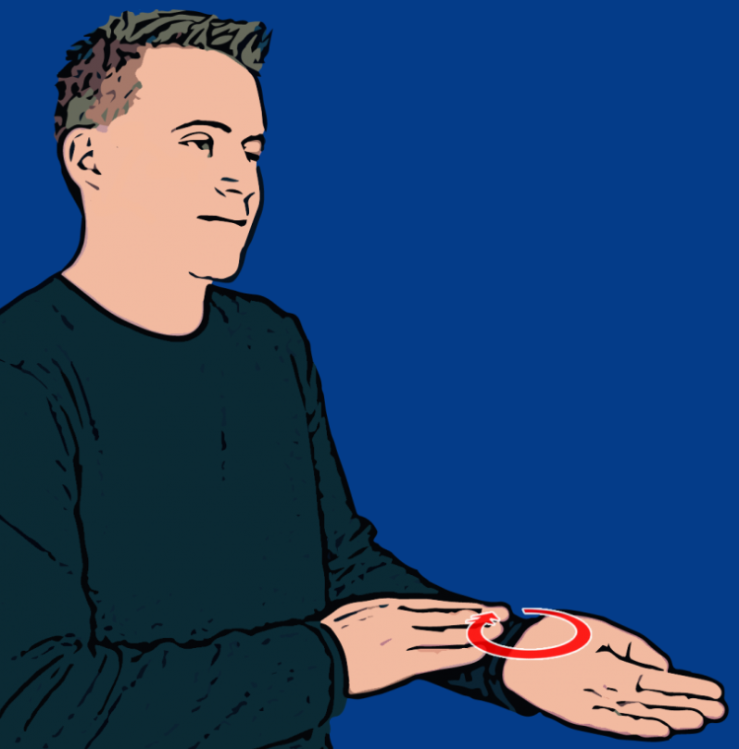
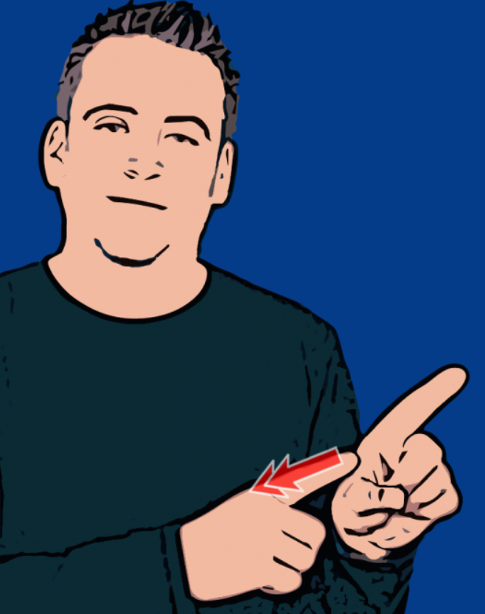
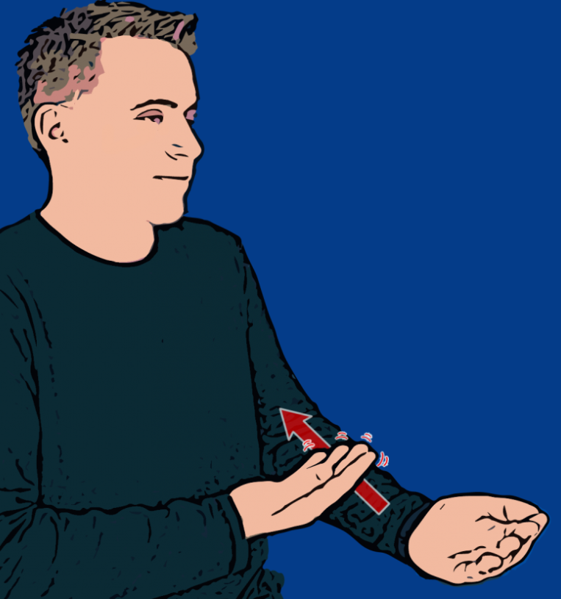
Colours
Orange
Partly open and close hand a few times.
Blue
Flat primary hand makes small circles in upturned wrist of secondary hand..
Yellow
Fingerspell 'Y' twice.
Green
Flat primary hand with palm facing up moves along secondary forearm while fingers wiggle slightly.
March – Sign Language
Language of the month
Sign Language for Colours: https://www.youtube.com/watch?v=QFxqblO2zlE

Slide 4
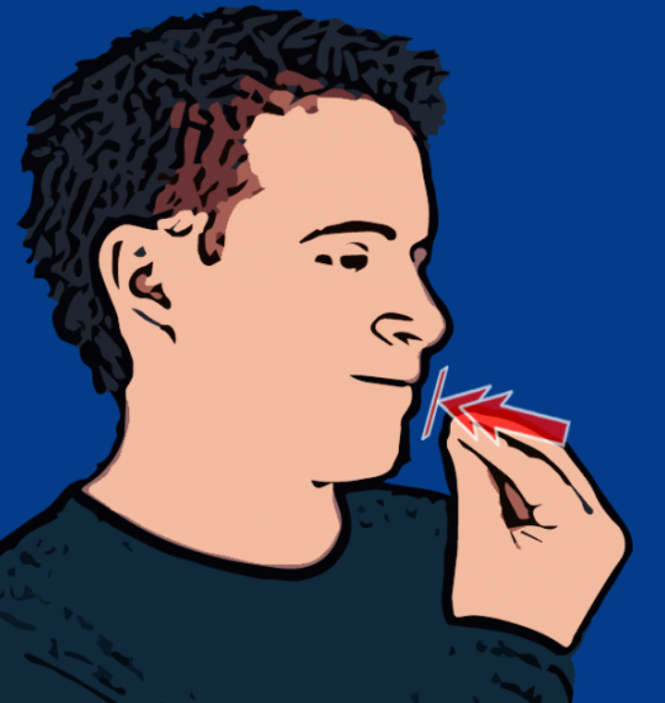


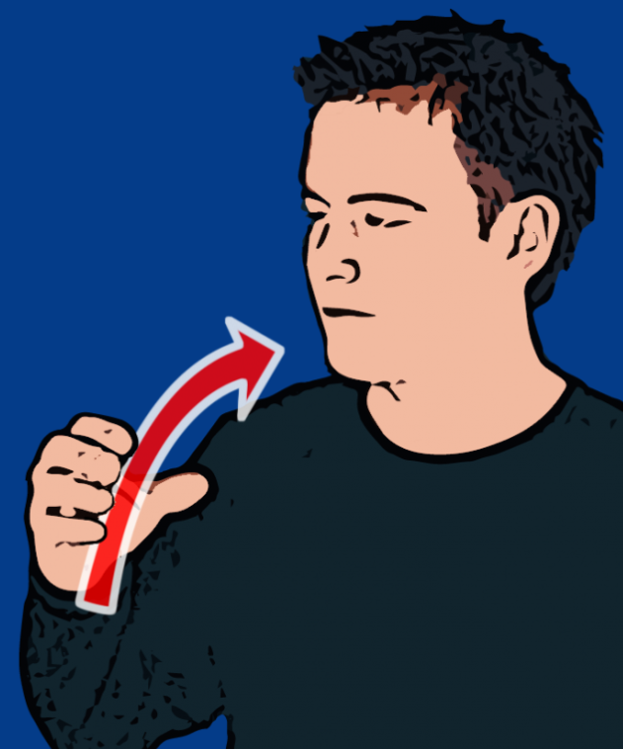
Lunch
Lunch
Please / Thank you
Fruit
Drink
March – Sign Language
Language of the month
Bunched fingers and thumb of primary hand tap mouth twice.
Flat hand starts with fingertips on chin. Hand moves down and away from signer.
Open primary hand with bent fingers (full C hand) facing mouth twists upwards and forwards.
Primary hand mimes drinking out of a glass.

Slide 5
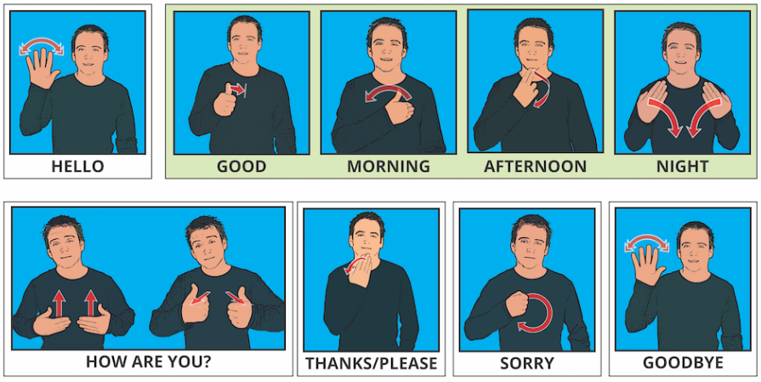
Greetings
March – Sign Language
Language of the month
Greetings and manners in British Sign Language:
https://www.youtube.com/watch?v=n09Rb3OTKfw

Slide 6










Numbers 1-10
One
Two
Three
Four
Five
March – Sign Language
Language of the month
Six
Seven
Eight
Nine
Ten
Numbers 1-10: https://www.youtube.com/watch?v=G1swqmQSJnM

Slide 7
Useful websites:
What is British Sign Language?:
https://www.british-sign.co.uk/what-is-british-sign-language/
Online British Sign Language dictionary:
https://www.british-sign.co.uk/british-sign-language/dictionary/
Signs for feelings and emotions:
https://www.youtube.com/playlist?list=PLibdbQXeyr22j4qbGGPyKjlHvxBn62bgK
Signed Nursery Rhymes (cbeebies):
https://www.youtube.com/watch?v=1l951PsA3Sg
March – Sign Language
Language of the month

