Slide 1
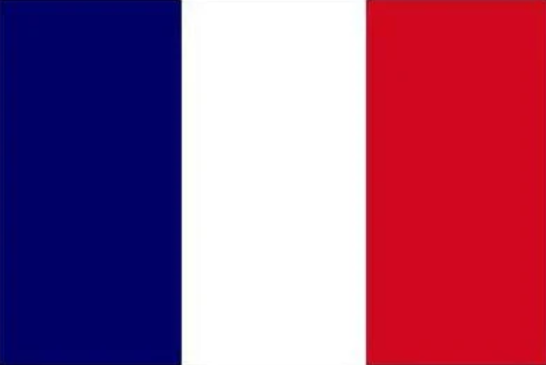
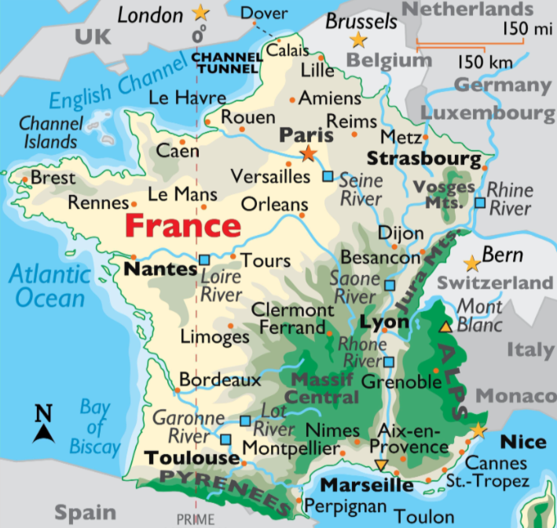

April - French
Language of the month
In April, people in France celebrate Poisson d’Avril, which means “April Fish,” by playing funny fish pranks and eating fish-shaped chocolates. At Pâques, which means “Easter,” children hunt for chocolate treats said to be dropped by flying church bells. April is also a time for fun festivals like Printemps de Bourges, which means “Springtime of Bourges,” and for visiting beautiful places like Claude Monet’s house in Giverny.

Slide 2

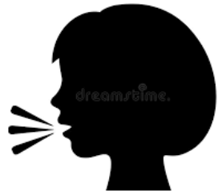
My name is Dimercia.
Mon nom est Dimercia.
I can speak French and English.
Je parle français et anglais.
April - French
Language of the month
I like to play tag.
J'aime jouer à chat.
I like to eat fries.
J'aime manger des frites.

Slide 3
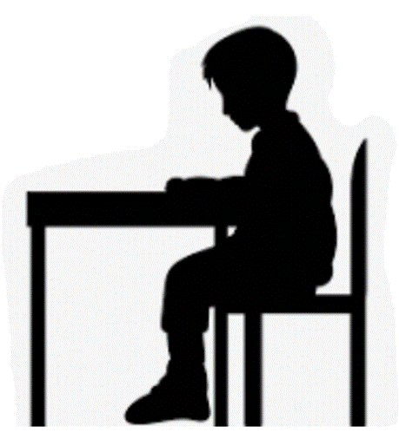
L’Appel – The Register
Bonjour,
monsieur.
Bon après-midi,
monsieur.
French | English
Bonjour | Hello or good day
Madame | Madam
Monsieur | Sir
Bon après-midi | Good afternoon
Bonjour,
madame.
April - French
Language of the month
Bon après-midi,
madame.

Slide 4
Les couleurs – Colours
bleu
rouge
jaune
April - French
Language of the month
vert
orange
https://www.youtube.com/watch?v=fZR66TjjrDc

Slide 5
Le Lunch – Lunch
Vert s’il vous plaît.
Orange s’il vous plaît.
Quelle
couleur?
Jaune s’il vous plaît.
April - French
Language of the month
Bleu s’il vous plait.
French | English
s’il vous plaît | please
merci | thank you
Quelle couleur? | Which colour?
panier-repas | packed lunch
Rouge s’il vous plaît.

Slide 6
Good morning
Bonjour
Thank you
Merci
Yes
Oui
Please
S’il vous plait
Hello
Bonjour
Sorry
Pardon
Well done
Bien joué
April - French
Language of the month
Good afternoon
Bon après-midi
Goodbye
Au revoir
No
Non
https://www.youtube.com/watch?v=bOdAzpZIS2U

Slide 7

One
Un
Three
Trois
Five
Cinq
Two
Deux
Four
Quatre
Six
Six
Eight
Huit
April - French
Language of the month
Ten
Dix
Seven
Sept
Nine
Neuf
https://www.youtube.com/watch?v=lsc3qLMaCu8

Slide 8
Useful websites:
Facts:
http://kids.nationalgeographic.com/geography/countries/article/france
French national anthem:
https://www.youtube.com/watch?v=PIQSEq6tEVs
Frère Jacques:
https://www.youtube.com/watch?v=XrPiWFxmY24
April - French
Language of the month

